Slide 1

SWE 321: Data Communication
SWE 321: Lecture 06
Afsana Begum
Department of Software Engineering
Daffodil International University

Slide 2
Overview:
Review
Analog-to-Digital Conversion
Pulse code modulation (PCM)
Sampling
Quantizing
Encoding
Transmission Modes
Parallel & Serial Transmission
Asynchronous, synchronous, and isochronous transmission

Slide 3
Digital Transmission:
ANALOG-TO-DIGITAL CONVERSION:
Previously we learn how to convert digital data to digital signals.
However, we have an analog signal such as one created by a microphone. So, we need to learn how to convert an analog signal to digital data.
There are two techniques to convert analog signal to digital data.
Pulse code modulation (PCM)
Delta modulation (DM)

Slide 4
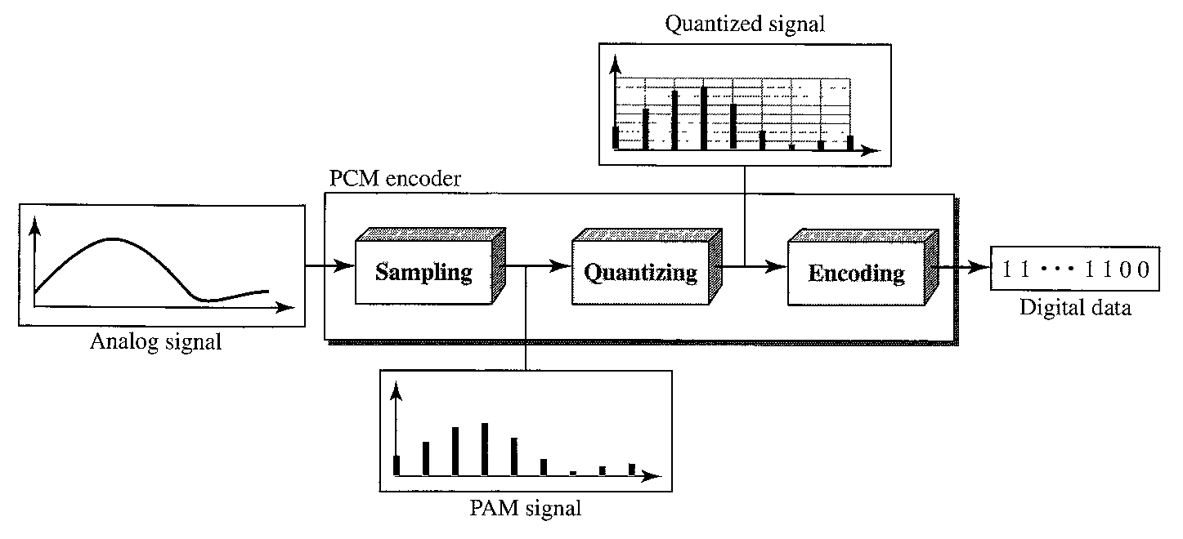
Digital Transmission:
Pulse Code Modulation (PCM):
The most common technique to change an analog signal to digital data (digitization) is called pulse code modulation (PCM).
PCM completed in the following three processes:

Slide 5
Digital Transmission:
Pulse Code Modulation (PCM):
Sampling:
The first step in PCM is sampling. The analog signal is sampled every Ts second, where Ts is the sample interval or period.
The inverse of the sampling interval is called the sampling rate or sampling frequency and denoted by fs.
There are three sampling methods: ideal, natural, and flat-top.
In ideal sampling, pulses from the analog signal are sampled. This is an ideal sampling method and cannot be easily implemented.

Slide 6
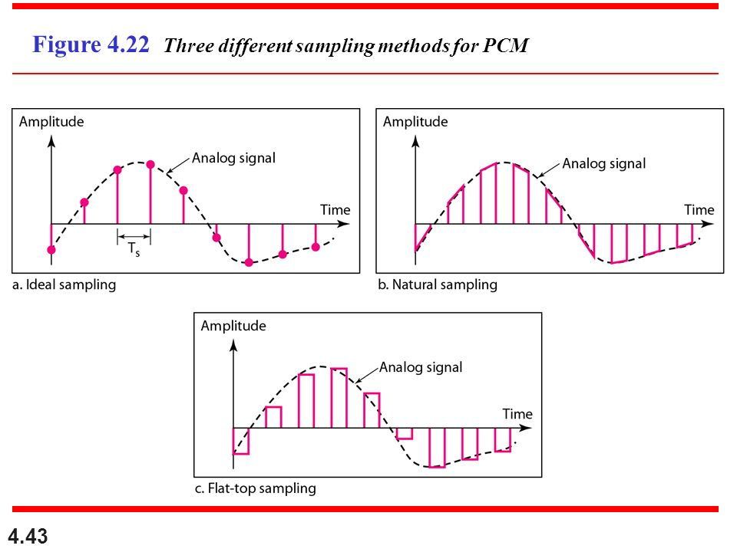
Digital Transmission:
Pulse Code Modulation (PCM):
In natural sampling, a high-speed switch is turned on for only the small period of time when the sampling occurs.
The most common sampling method, called sample and hold, however, creates flat-top samples by using a circuit.

Slide 7
Digital Transmission:
Pulse Code Modulation (PCM):
Sampling and Nyquist Theorem:
One important consideration is the sampling rate or frequency. What are the restrictions on fs?
According to the Nyquist theorem, the sampling rate must be at least 2 times the highest frequency contained in the signal. Therefore, fs = 2 f.
Sampling can be done by according to Nyquist theory or by over-sampling or by under-sampling.

Slide 8
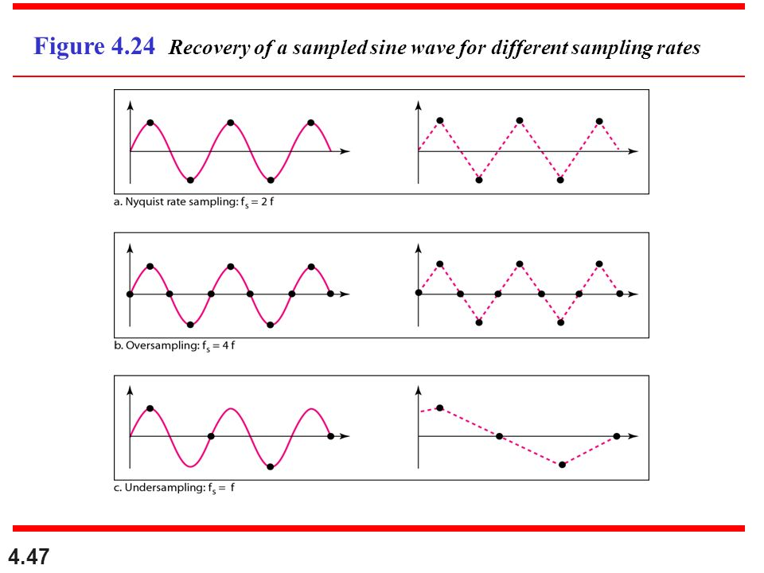
Digital Transmission:
Sampling in different sampling rates:

Slide 9
Digital Transmission:
Pulse Code Modulation (PCM):
Quantization:
The result of sampling is a series of pulses with amplitude values between the maximum and minimum amplitudes of the signal. The following are the steps in quantization:
We assume that the original analog signal has instantaneous amplitudes between Vmin and Vmax
We divide the range into L zones, each of height ∆/D(delta).
We assign quantized values of 0 to (L-1) to the midpoint of each zone.
We approximate the value of the sample amplitude to the quantized values.

Slide 10
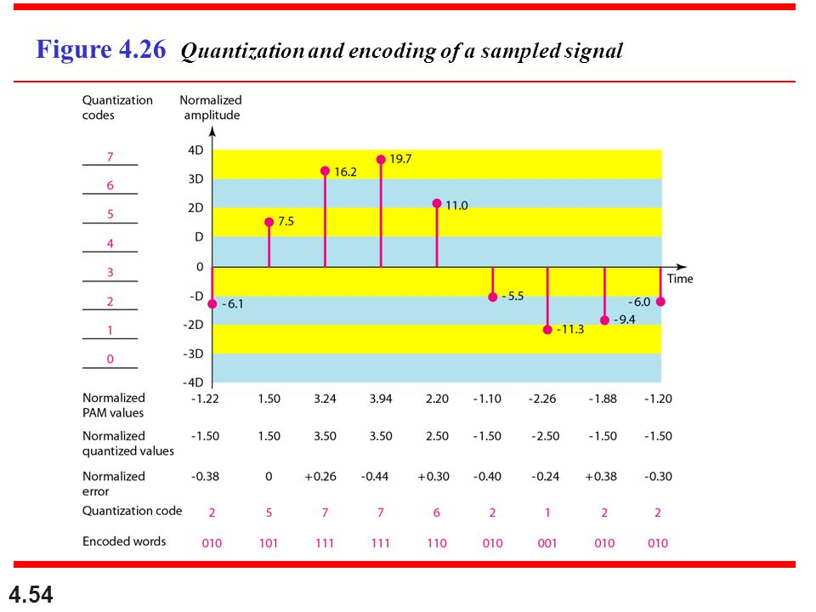
Digital Transmission:
Pulse Code Modulation (PCM):
Quantization:
The following example will illustrate all:

Slide 11
Digital Transmission:
Pulse Code Modulation (PCM):
Encoding:
The last step in PCM is encoding. After each sample is quantized and the number of bits per sample is decided, each sample can be changed to an Nb-bit code word.
A quantization code of 2 is encoded as 010; 5 is encoded as 101; and so on.
The number of bits for each sample is determined from the number of quantization levels. If the number of quantization levels is L, the number of bits is Nb=log2 L. In our example L is 8 and Nb is therefore 3.

Slide 12
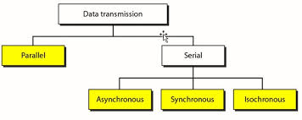
Digital Transmission:
TRANSMISSION MODES:
The transmission of binary data across a link can be accomplished in either parallel or serial mode.
In parallel mode, multiple bits are sent with each clock tick. In serial mode, 1 bit is sent with each clock tick.
There is only one way to send parallel data, but there are three subclasses of serial transmission: asynchronous, synchronous, and isochronous.

Slide 13
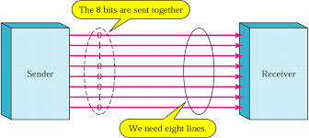
Digital Transmission:
TRANSMISSION MODES:
Parallel Transmission:
Binary data, consisting of 1s and Os, may be organized into groups of n bits each. By grouping, we can send data n bits at a time instead of 1. This is called parallel transmission.
The mechanism for parallel transmission is a conceptually simple one: Use n wires to send n bits at one time.

Slide 14
Digital Transmission:
TRANSMISSION MODES:
Parallel Transmission:
The advantage of parallel transmission is speed. All else being equal, parallel transmission can increase the transfer speed by a factor of n over serial transmission.
There is a significant disadvantage which is cost. Parallel transmission requires n communication lines (wires) just to transmit the data stream. Because this is expensive, parallel transmission is usually limited to short distances.

Slide 15
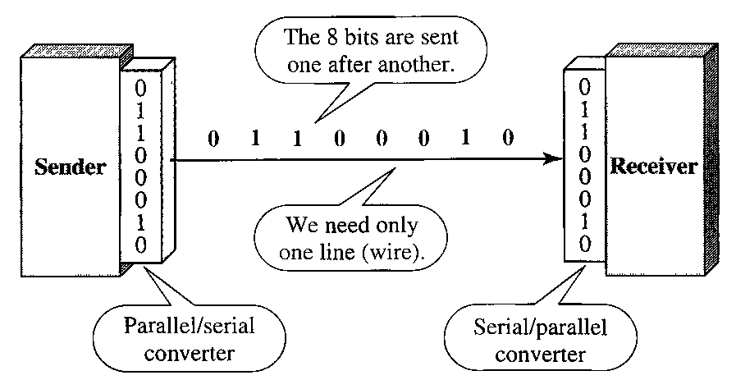
Digital Transmission:
TRANSMISSION MODES:
Serial Transmission:
In serial transmission one bit follows another, so we need only one communication channel rather than n to transmit data between two communicating devices.

Slide 16
Digital Transmission:
TRANSMISSION MODES:
Serial Transmission:
The advantage of serial over parallel transmission is that with only one communication channel, serial transmission reduces the cost of transmission over parallel.
Since communication within devices is parallel, conversion devices are required at the interface between the sender and the line (parallel-to-serial) and between the line and the receiver (serial-to-parallel).
Serial transmission occurs in one of three ways: asynchronous, synchronous, and isochronous

Slide 17
Digital Transmission:
Serial Transmission:
Asynchronous Transmission:
Asynchronous transmission is named because the timing of a signal is unimportant. Instead, information is received and translated by agreed upon patterns.
Without synchronization, the receiver cannot use timing to predict when the next group will arrive. To alert the receiver to the arrival of a new group, therefore, an extra bit is added to the beginning of each byte.
In asynchronous transmission, we send 1 start bit (0) at the beginning and 1 or more stop bits (1s) at the end of each byte. There may be a gap between each byte.

Slide 18
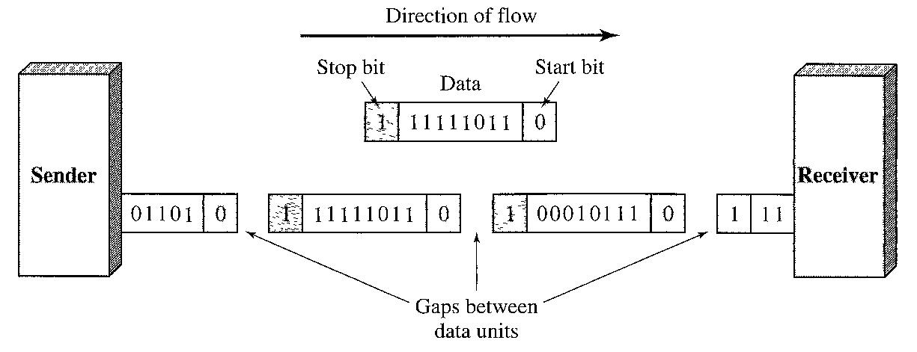
Digital Transmission:
Serial Transmission:
Asynchronous Transmission:
By this method, each byte is increased in size to at least 10 bits, of which 8 bits is information and 2 bits or more are signals to the receiver.
Advantages: Cheap and effective.
Disadvantages: Slower form of transmission.
Example: the connection of a keyboard to a computer is a natural application for asynchronous transmission.

Slide 19
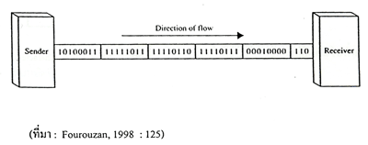
Digital Transmission:
Serial Transmission:
Synchronous Transmission:
In synchronous transmission, the bit stream is combined into longer "frames," which may contain multiple bytes.
In synchronous transmission, we send bits one after another without start or stop bits or gaps. It is the responsibility of the receiver to group the bits.

Slide 20
Digital Transmission:
Serial Transmission:
Synchronous Transmission:
Without gaps and start and stop bits, there is no built-in mechanism to help the receiving device adjust its bit synchronization midstream, therefore, timing becomes very important.
The advantage of synchronous transmission is speed. synchronous transmission is faster than asynchronous transmission.
For this reason, it is more useful for high-speed applications such as the transmission of data from one computer to another. Byte synchronization is accomplished in the data link layer.

Slide 21
Thanks…
Any Questions ???

